Slide 1


Connecticut Property Sales Trends
Northeastern University: College of Professional Studies
ALY 6070: Communication and Visualization for Data Analytics
Submitted to Professor: Jack Bergersen
Submitted by: Sangayya Hiremath
Date: 30/01/2025

Slide 2
Introduction
Connecticut, with a population of 3.6 million and an area of 5,543 square miles, has a strong economy driven by finance, healthcare, and manufacturing, contributing to a GDP of over $350 billion. Major cities like Bridgeport, Stamford, New Haven, and Hartford serve as economic hubs, influencing real estate demand.
The real estate market is strongest in urban and coastal areas, with higher property values in Fairfield County. Sales prices have risen post-2020, showing increasing demand, while assessed values remain relatively stable. The market offers both luxury and affordable housing, making it diverse and investment-friendly.
Goal of The Analysis
Analyze property sales trends across Connecticut.
Compare assessed values with actual sale prices.
Examine property type distribution and dominance.
Evaluate town-wise real estate performance.

Slide 3
Research Questions
How have Connecticut's property sales trends changed over time, and what regional differences can be observed?
What is the relationship between assessed property values and actual sales amounts over time?
What is the distribution of different property types in Connecticut, and which type dominates the market?
How do sales values vary across different residential property types, and which type generates the highest sales?
How do assessed values compare to sales values across different towns in Connecticut, and which towns have the highest and lowest property values?

Slide 4
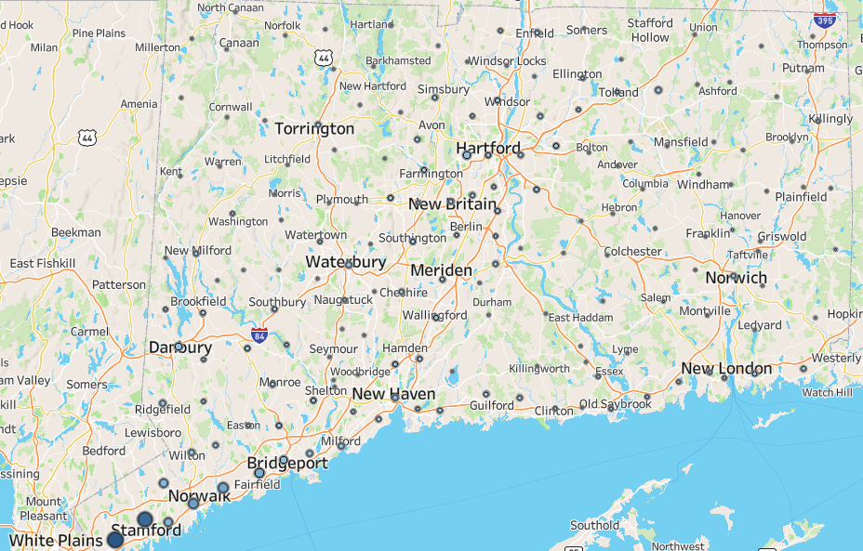
The long-term trends in Connecticut's property sales and how have they varied by region
Higher Sales in Urban & Coastal Areas – Stamford, Bridgeport, New Haven, and Hartford show higher property sales, driven by economic activity and housing demand.
Lower Sales in Rural & Inland Areas – Regions like Torrington and Windham have lower sales, likely due to lower demand, demographic shifts, and slower development.

Slide 5
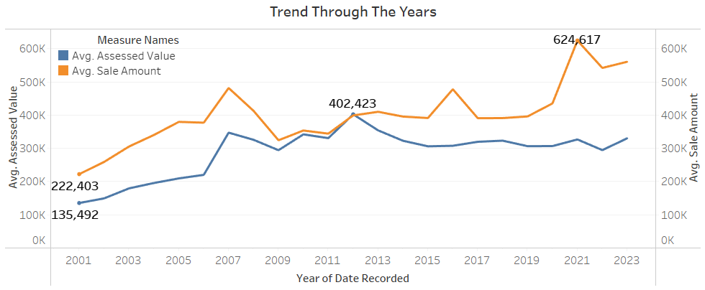
2) Assessed Value And Sales Amount Over Time
Increasing Sales Price Over Time – The average sale amount has shown a significant upward trend, especially after 2020, peaking at $624,617, indicating rising property values.
Stable Assessed Values – While assessed values have increased gradually, they have not risen as sharply as sales prices, suggesting a growing gap between market prices and official property assessments.

Slide 6
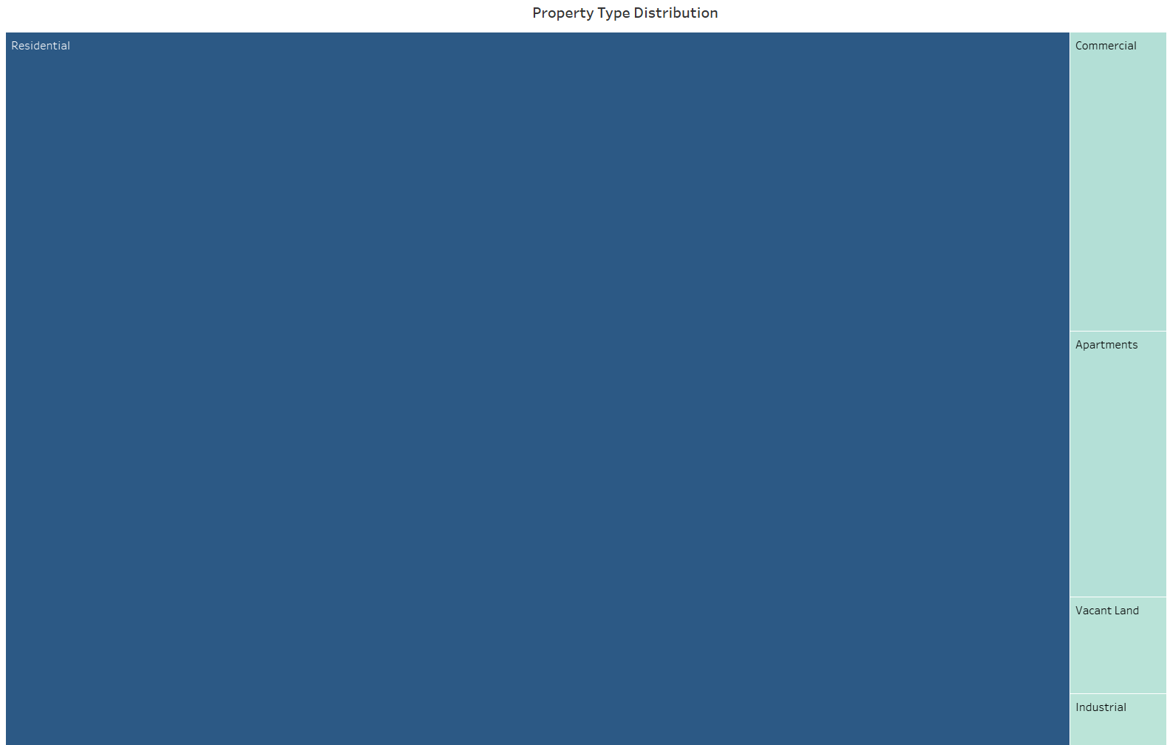
3) Treemap of Property Type Distribution
Residential properties dominate the distribution, occupying the largest portion, indicating a strong market for housing in Connecticut.
Non-residential types (Commercial, Apartments, Vacant Land, Industrial) are significantly smaller in comparison, suggesting lower sales volume or availability in these categories.

Slide 7
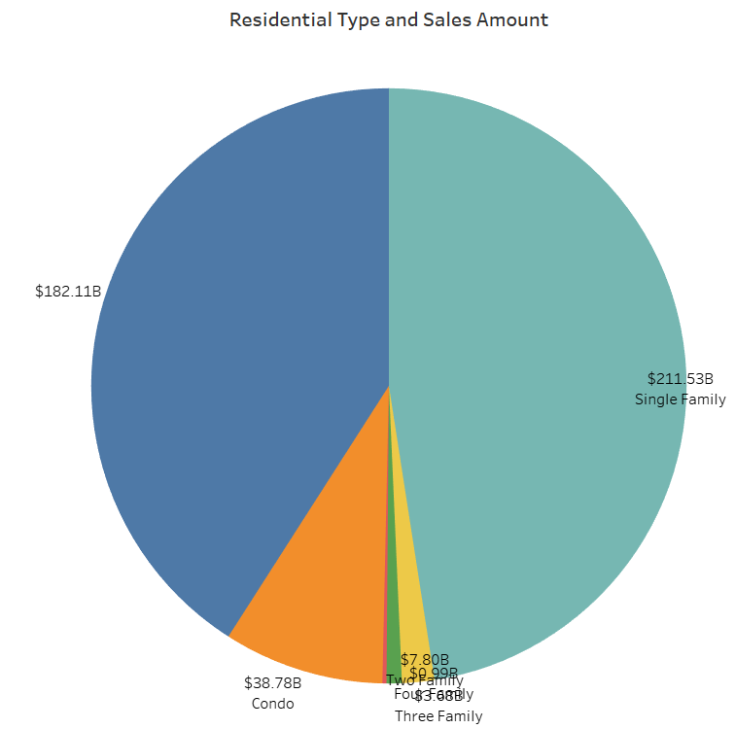
4) Pie Chart of Sales Values by Residential Type
Single-family homes dominate sales with the highest value, indicating they are the most transacted residential property type in Connecticut.
Condos have significantly higher sales than other multi-family units, suggesting stronger demand compared to two-family, three-family, and four-family properties.

Slide 8
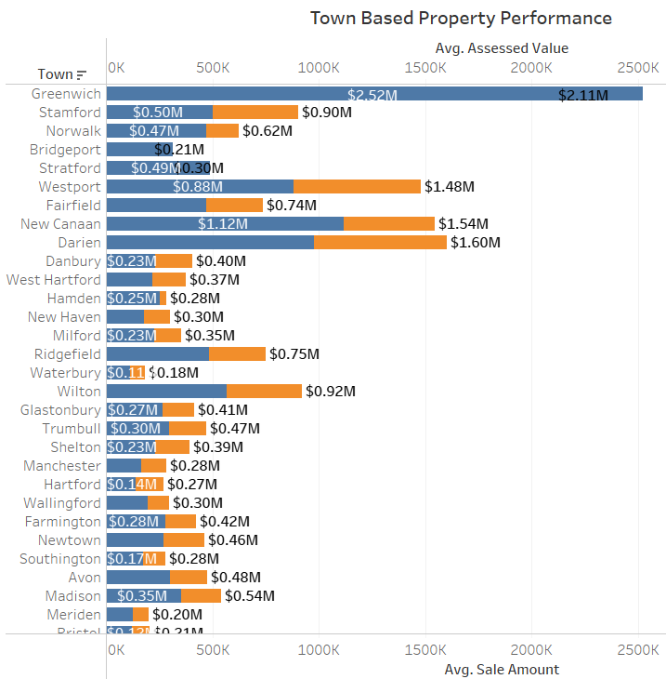
5) Town Based Property Performance (Assessed value & Sales value)
Greenwich leads in property value with the highest assessed and sale amounts, indicating a premium real estate market in the town.
New Canaan and Darien show high sales values exceeding assessed values, suggesting strong demand and appreciation in these areas.
Waterbury has the lowest assessed and sale values, indicating a more affordable real estate market compared to other towns in Connecticut.

Slide 9
Summary/Insights
Regional Sales Trends: Urban & coastal areas (Stamford, Bridgeport, New Haven, Hartford) experience higher property sales due to economic activity, while rural & inland areas (Torrington, Windham) see lower sales due to slower development.
Market Value Trends: Sales prices have significantly increased post-2020, peaking at $624,617, while assessed values remain relatively stable, indicating a widening gap between market prices and property assessments.
Property Type Distribution: Residential properties dominate the market, while non-residential categories (Commercial, Industrial, Vacant Land) contribute a smaller share.
Residential Sales Breakdown: Single-family homes lead in sales, highlighting their market dominance, while condos show stronger demand than other multi-family units.
Town-Based Performance: Greenwich leads in property value, while New Canaan & Darien show strong appreciation. Waterbury remains the most affordable market.

Slide 10
References
Gavrikova, E., Volkova, I., & Burda, Y. (2020). Strategic aspects of asset management: An overview of current research. Sustainability, 12(15), Article 5955. https://doi.org/10.3390/su12155955[^8^].
OpenGov. (n.d.). Strategic asset management (SAM): An in-depth guide. https://opengov.com/strategic-asset-management/[^8^].
Hackernoon. (2023, March 13). 14 Best Tableau Datasets for Practicing Data Visualization. Hacker Noon. https://hackernoon.com/14-best-tableau-datasets-for-practicing-data-visualization
Dataisgood. (2023, October 5). Tableau for Real Estate: How to analyze your real estate data. Data is Good. https://dataisgood.com/tableau-for-real-estate-how-to-analyze-your-real-estate-data/

Slide 11
Thank you!

